Slide 1
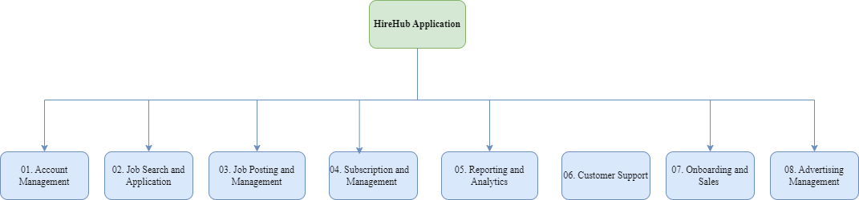
HireHub: Functional Decomposition Diagram

Slide 2
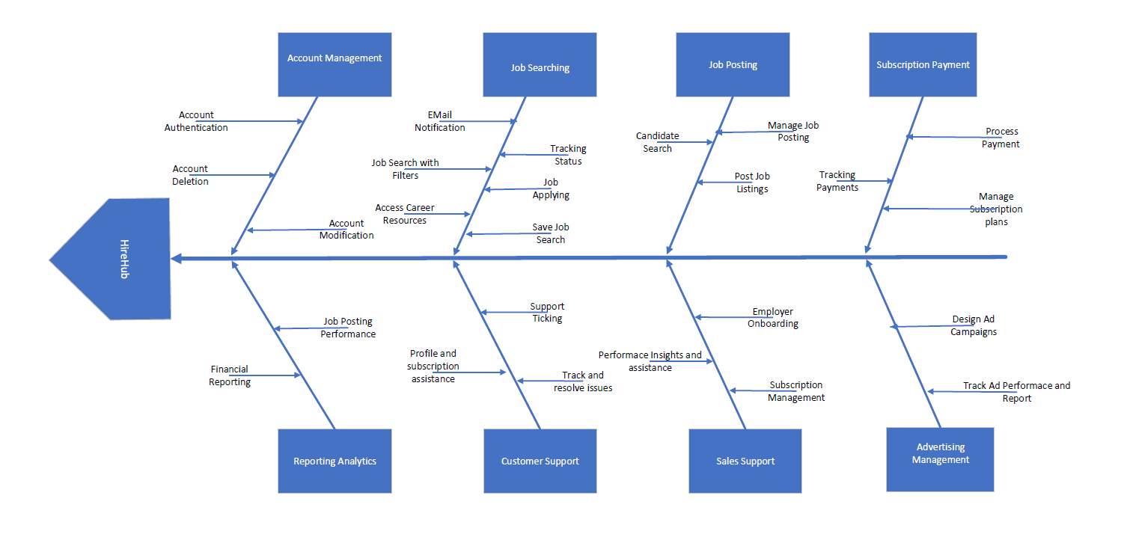
HireHub: Fish-bone Diagram

